Slide 1
Visualization of Harry Potter Board Game

Slide 2

Introduction
Harry Potter Board Game
Potter Head
Entertainment

Slide 3
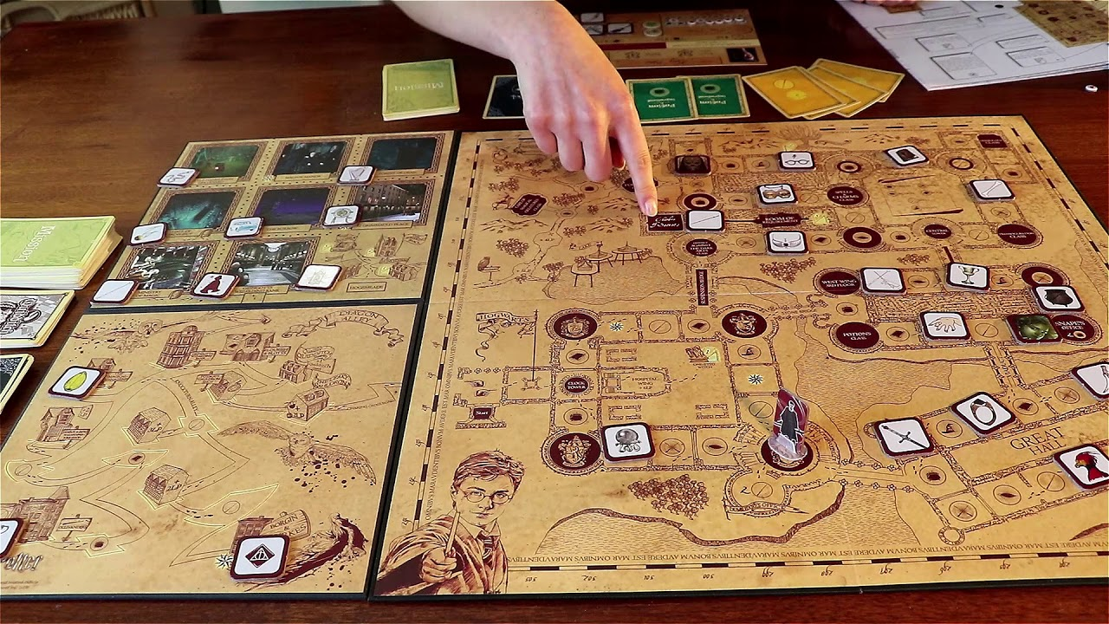
Harry Potter: Wizarding Quest
Game Play:

Slide 4
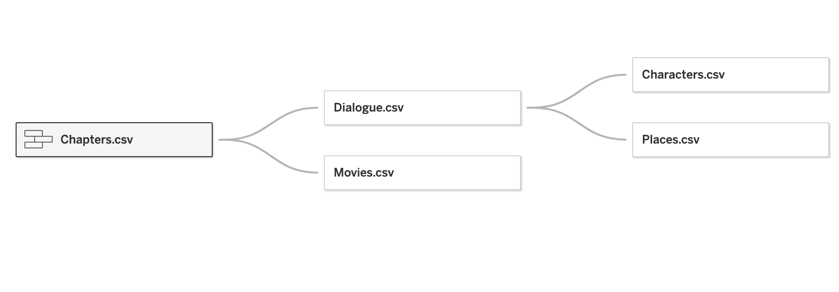
Database:

Slide 5
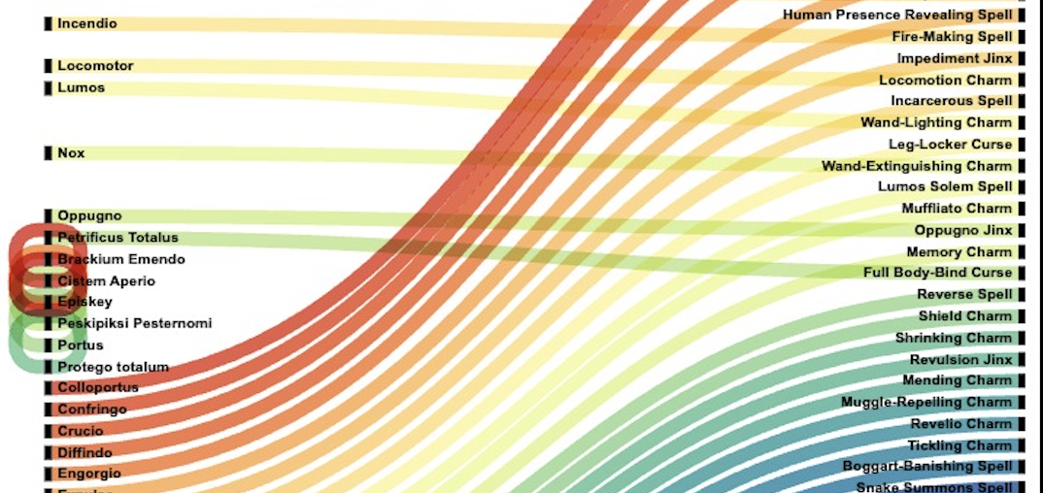
Graphs:

Slide 6
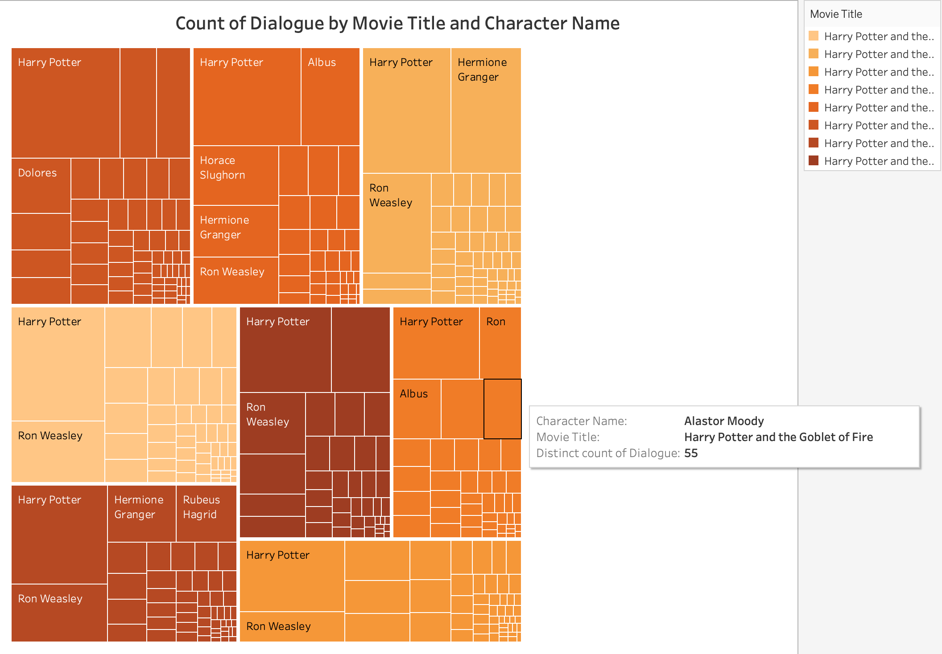

Slide 7
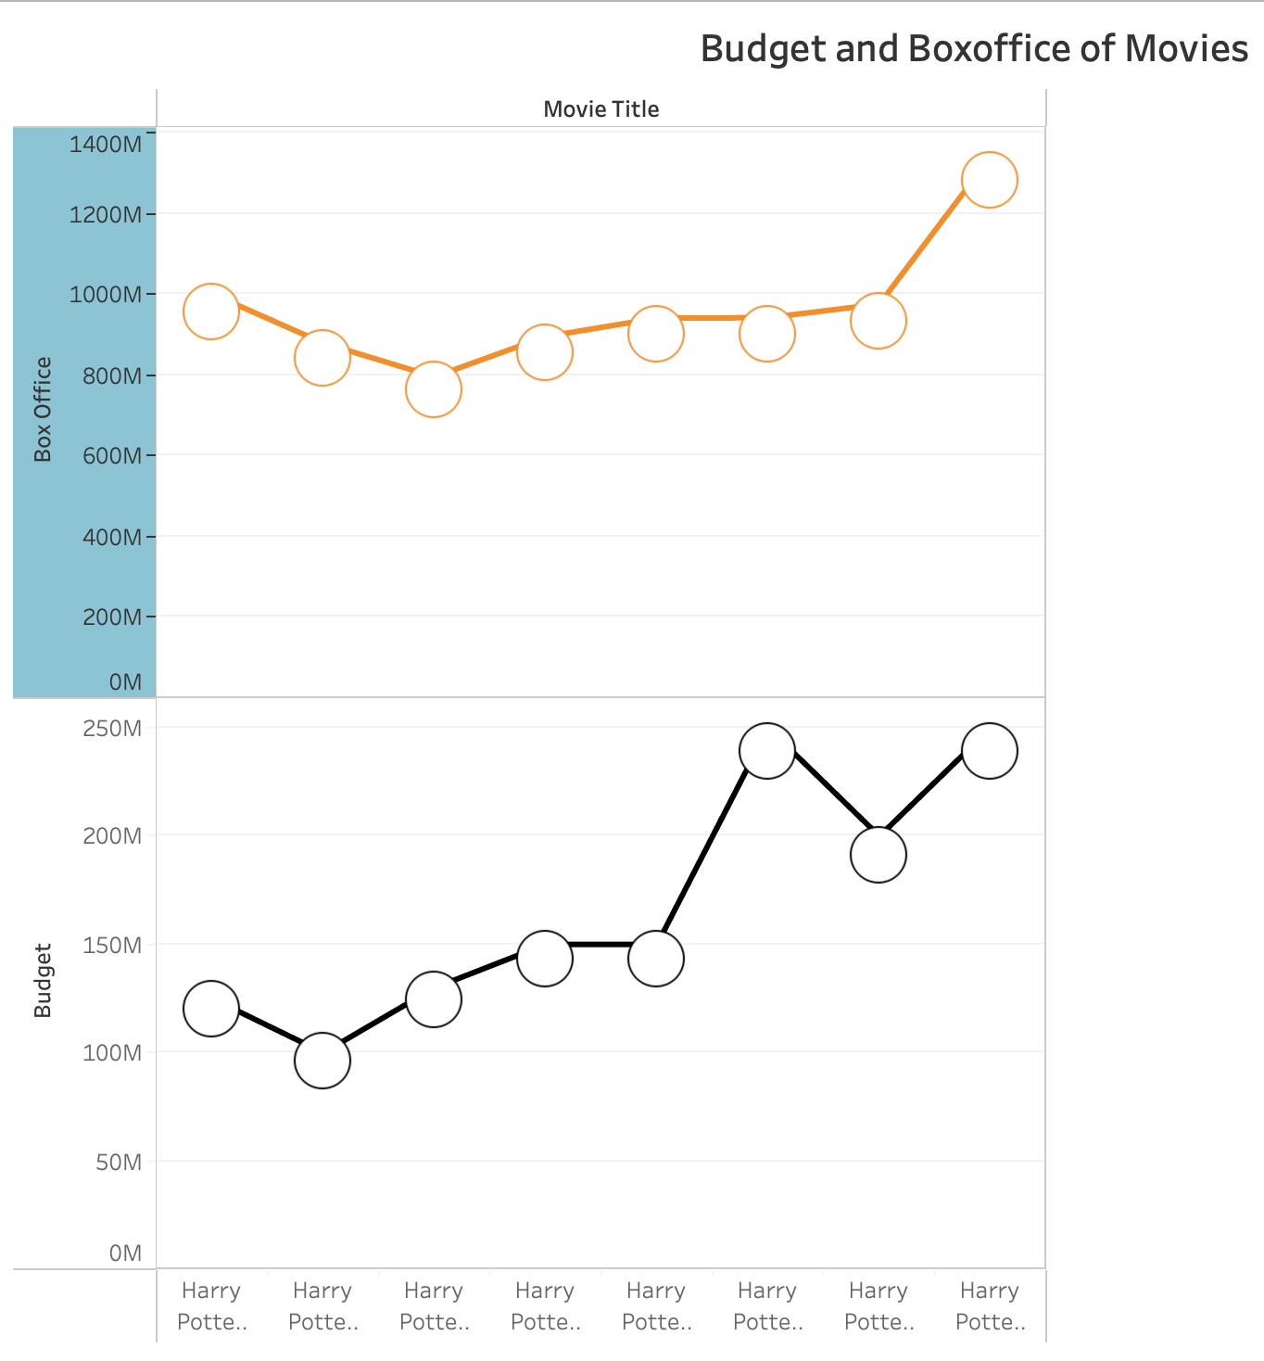

Slide 8
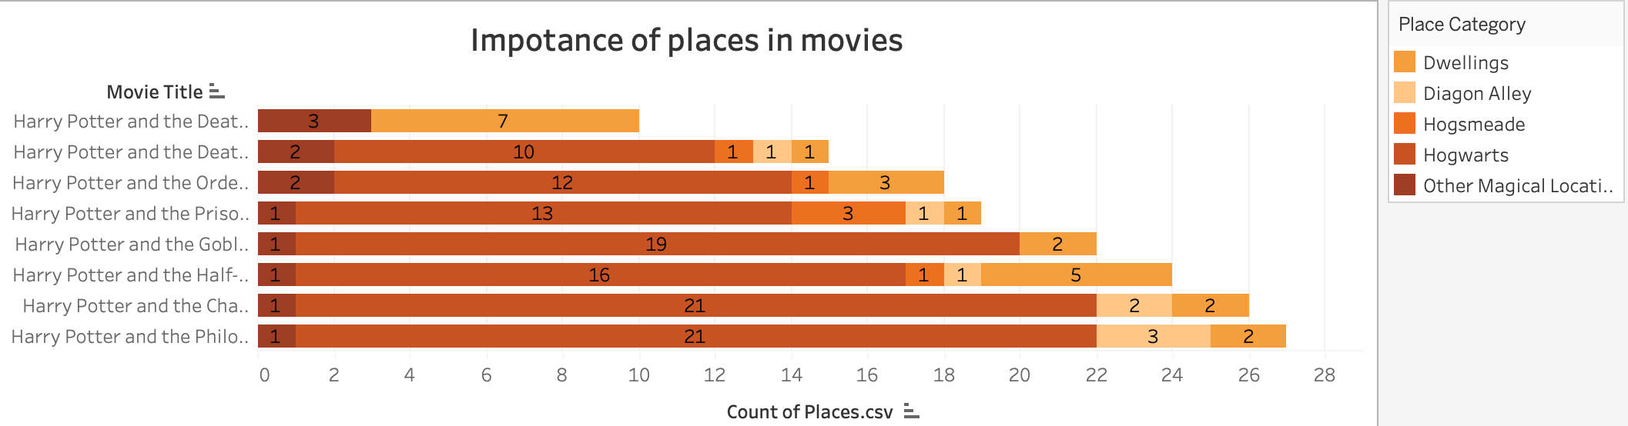

Slide 9
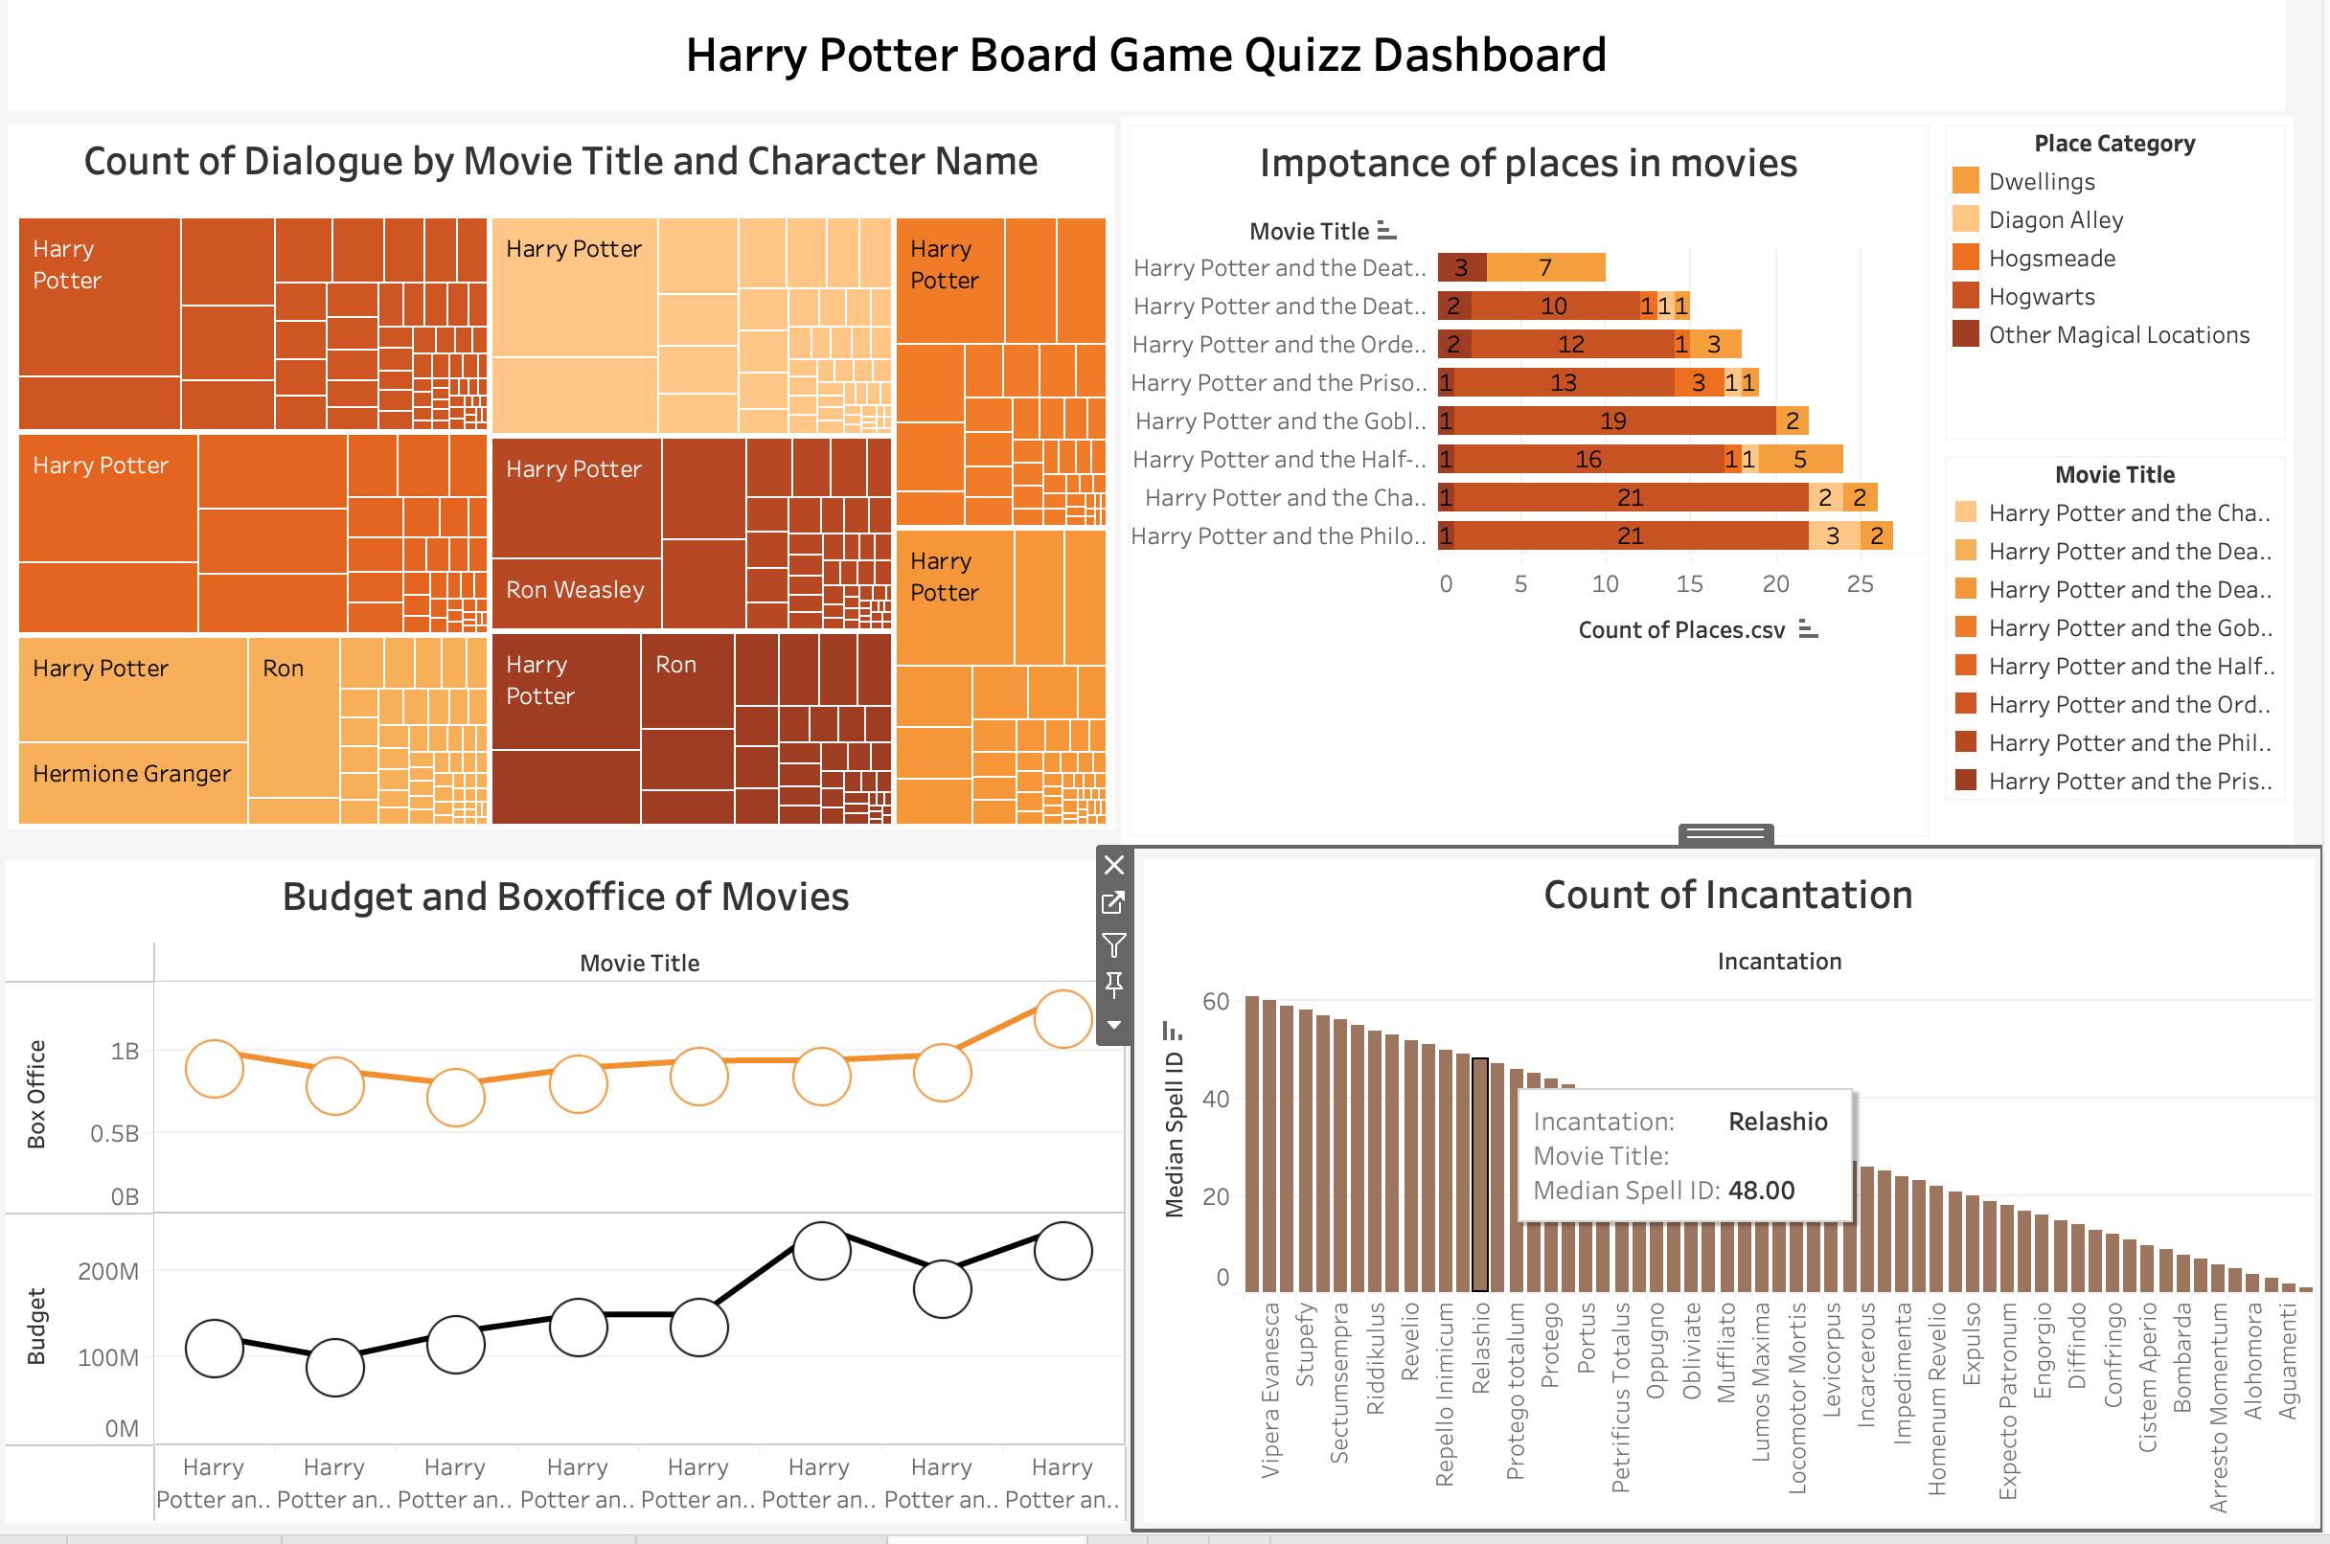
Dashboard

Slide 10
Conclusion:
Integrating a Tableau interactive dashboard into the design of the Harry Potter Board Game
valuable insights
Fresh Perspective
visually captivating

Slide 11
Thank You…

